Slide 1
……………………………
Pausing and Joining Threads
………………

Slide 2

Threads can be paused by the sleep() method.
For example, to have MyThread pause for half a second before it prints the next number, we add the following lines of code to our for loop.
for (int ctr=0; ctr < 500; ctr++) { System.out.print(i);
try {
Thread.sleep(500); // 500 miliseconds
} catch (InterruptedException e) { }
}
Thread.sleep() is a static method of class thread and can be invoked from any thread, including the main thread.

Slide 3
for (int ctr=0; ctr < 500; ctr++) { System.out.print(i);
try {
Thread.sleep(500); // 500 miliseconds
} catch (InterruptedException e) { }
}
The InterruptedException is an unchecked exeception that is thrown by code that stops a thread from running.
– Unchecked exception causing lines must be enclosed in a try-catch, in this case, Thread.sleep().
An InterruptedException is thrown when a thread is waiting, sleeping, or otherwise paused for a long time and another thread interrupts it using the interrupt() method in class Thread.

Slide 4


You can also make a thread stop until another thread finishes running by invoking a thread's join() method.
For instance, to make our main thread to stop running until
thread t1 is finished, we could simply say...
public static void main(String args[]) {
...
t1.start();
try {
t1.join();
} catch (InterruptedException e) { }
t2.start();
This would cause all the 1's to be printed out before thread 2 and thread 3 start.

Slide 5
……………………………
Critical Section Problem
………………

Slide 6
This section we will find out how to implement a solution to the critical section problem using Java
Recall that only a single process can enter its critical section,
all other processes would have to wait
– No context switching occurs inside a critical section

Slide 7
Instead of printing a continuous stream of numbers, MyThread calls a print10() method in a class MyPrinter
print10() prints 10 continuous numbers on a single line before a newline.
Our goal is to have these 10 continuous numbers printed
without any context switches occuring.
Our output should be:
...
1111111111
1111111111
2222222222
3333333333
1111111111
...

Slide 8

We define a class MyPrinter that will have our print10() method
class MyPrinter {
public void print10(int value) {
for (int i = 0; i < 10; i++) { System.out.print(value);
}
System.out.println(""); // newline after 10 numbers
}
}

Slide 9

Instead of printing numbers directly, we use the print10() method in MyThread, as shown by the following
class MyThread extends Thread { int i;
MyPrinter p;
MyThread(int i) {
this.i = i;
p = new MyPrinter();
}
public void run() {
for (int ctr=0; ctr < 500; ctr++) {
p.print10(i);
}
}
}

Slide 10

First, we will try to see the output of just a single thread running.
class MyThreadDemo {
public static void main(String args[]) {
MyThread t1 = new MyThread(1);
// MyThread t2 = new MyThread(2);
// MyThread t3 = new MyThread(3);
t1.start();
// t2.start();
// t3.start();
System.out.print("Main ends");
}}
We comment out the other threads for now...

Slide 11

When we run our MyThreadDemo, we can see that the output really does match what we want.
> java MyThreadDemo 1111111111
1111111111
1111111111
1111111111
1111111111
...

Slide 12
However, let us try to see the output with other threads.
class MyThreadDemo {
public static void main(String args[]) { MyThread t1 = new MyThread(1); MyThread t2 = new MyThread(2); MyThread t3 = new MyThread(3); t1.start();
t2.start();
t3.start();
System.out.print("Main ends");
}}
We run all three threads

Slide 13
Our output would look like the following
> java MyThreadDemo 1111111111
111112222222
1111
22233333332
...
We do not achieve our goal of printing 10 consecutive numbers in a row
– all three threads are executing the print10's method at the same time, thus having more than one number appearing on a single line.

Slide 14

To achieve our goal there should not be any context switches happening inside print10()
– Only a single thread should be allowed to execute inside print10()
As can be seen, this is an example of the critical section problem
To solve this, we can use some of the techniques discussed in our synchronization chapter

Slide 15

Busy Wait
Wait and Notify
Semaphores
Monitors

Slide 16

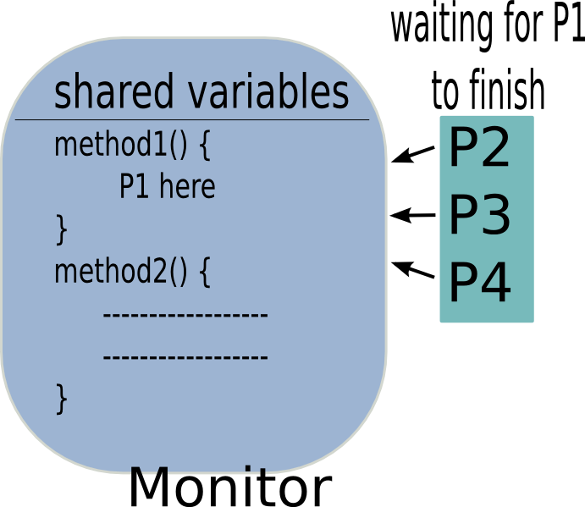
Now we will discuss Java's solution to the critical section problem
Java uses a monitor construct
– Only a single thread may run
inside the monitor
Even if P2 is calling method2(), it
has to wait for P1 to finish

Slide 17
To turn an object into a monitor, simply put the synchronized keyword on your method definitions
– Only a single thread can run any synchronized method in an object
class MyPrinter {
public synchronized void print10(int value) { for (int i = 0; i < 10; i++) {
System.out.print(value);
}
System.out.println(""); // newline after 10
numbers
}
}

Slide 18

However, even if we did turn our print10() method into a synchronized method, it will still not work
> java MyThreadDemo
1111111111
111112222222
1111
22233333332
...
To find out how to make it work, we need to first find out how the synchronized keyword works

Slide 19

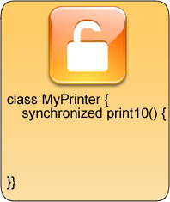
Every object in Java has an intrinsic lock

Slide 20
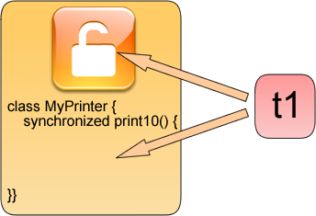
When a thread tries to run a synchronized method, it first tries to get a lock on the object

Slide 21
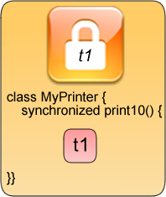
If a thread is successful, then it owns the lock and executes the synchronized code.

Slide 22
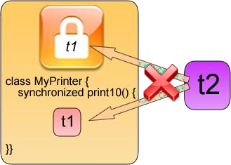
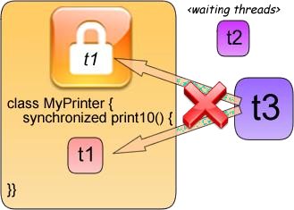
Other threads cannot run the synchronized code because the lock is unavailable

Slide 23


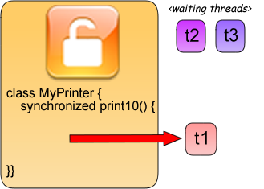
Threads can only enter once the thread owning the lock leaves the synchronized method

Slide 24

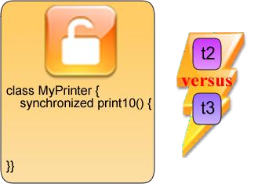
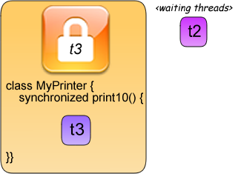
Waiting threads would then compete on who gets to go next

Slide 25

So why doesn't our example work?
Because each thread has its own copy of the MyPrinter object!
class MyThread extends Thread {
int i;
MyPrinter p; MyThread(int i) {
this.i = i;
p = new MyPrinter();
its own MyPrinter!
}
public void run() {
// each MyThread creates
for (int ctr=0; ctr < 500; ctr++) {
p.print10(i);
}
}
}

Slide 26

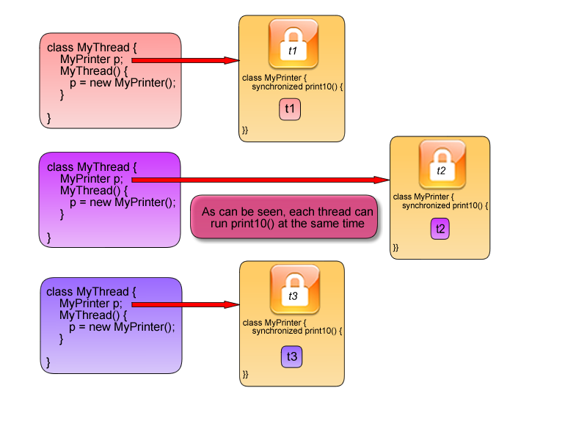

Slide 27

Recall our definition of synchronized methods
– Only a single thread can run any synchronized method in an object
Since each thread has its own MyPrinter object, then no
locking occurs

Slide 28

So, to make it work, all threads must point to the same MyPrinter object

Slide 29


Note how all MyThreads now have the same MyPrinter object
class MyThread extends Thread {
int i;
MyPrinter p;
MyThread(int i, MyPrinter p) {
this.i = i; this.p = p
}
public synchronized void run() {
for (int ctr=0; ctr < 500;
ctr++) {
p.print10(i);
}
}
}
class MyThreadDemo {
public static void main(String args[]) {
MyPrinter p = new
MyPrinter();
MyThread t1 = new
MyThread(1,p);
MyThread t2 = new
MyThread(2,p);
MyThread t3 = new
MyThread(3,p);
t1.start();
t2.start();
t3.start();
}}

Slide 30
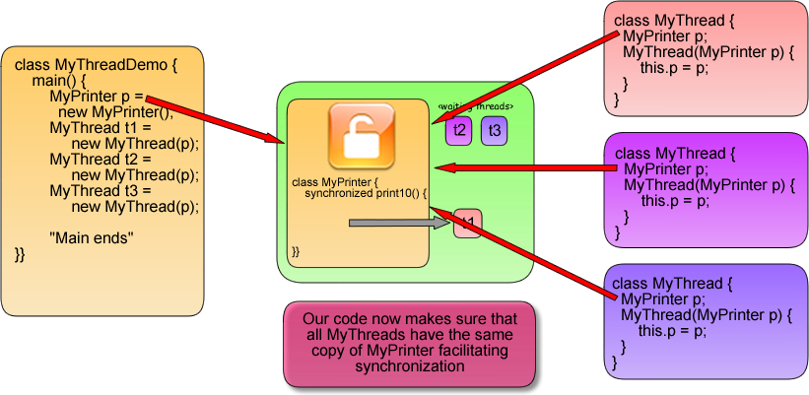

Slide 31

A way to visualize it is that all Java objects can be doors
A thread tries to see if the door is open
Once the thread goes through the door, it locks it behind it,
No other threads can enter the door because our first thread has
locked it from the inside
Other threads can enter if the thread inside unlocks the door and goes
out
Lining up will only occur if everyone only has a single door to the
critical region

Slide 32

Running MyThreadDemo now correctly shows synchronized methods at work
>java MyThreadDemo
1111111111
1111111111
1111111111
2222222222
3333333333
...

Slide 33

Only a single thread can run any synchronized method in an object
– If an object has a synchronized method and a regular method, only one thread can run the synchronized method while multiple threads can run the regular method
Threads that you want to have synchronized must share the same monitor object

Slide 34

Aside from synchronized methods, Java also allows for synchronized blocks.
You must specify what object the intrinsic lock comes from

Slide 35
Our print10() implementation, done using synchronized statements, would look like this
class MyPrinter {
public void print10(int value) {
synchronized(this) {
for (int i = 0; i < 10; i++) {
System.out.print(value);
}
System.out.println(""); // newline after
10 numbers
}
}
}
We use a MyPrinter object for the lock, replicating what the synchronized method does

Slide 36
Synchronized blocks allow for flexibility, in the case if we want our intrinsic lock to come from an object other than the current object.
For example, we could define MyThread's run method to perform the lock on the MyPrinter object before calling print10
class MyThread extends Thread {
MyPrinter p;
...
public void run() {
for (int i = 0; i < 100; i++) {
synchronized(p) {
p.print10(value);
}
}}}
Note that any lines before and after our synchronized block can be executed concurrently by threads

